Slide 1
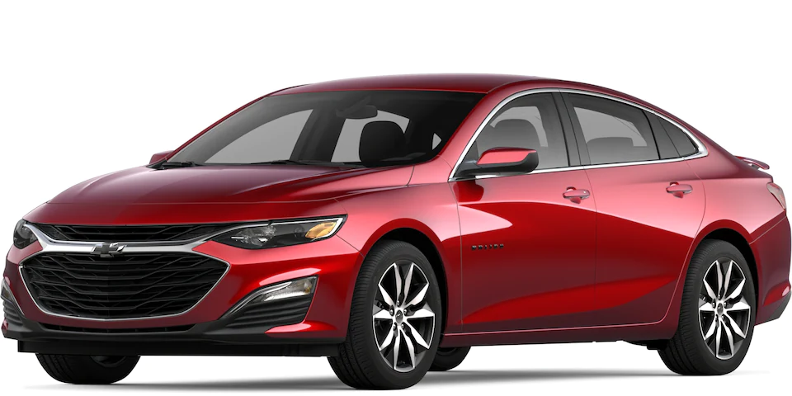
RENTAl CAR revenue Analysis
Prepared for: Lariat-rent-a car
by Elie TSHIMANGA

Slide 2
BACKGROUND
LARIAT-RENT-A CAR has hired us to perform some analysis of the costs and revenue generated by their car fleet across the USA.
IN order to use our expertise for a smarter business decision
The Company has(owns) ressort all across the United state
In each location they rent a variety of cars:-fair price
-accessible to everyone

Slide 3
Goals
The company’s chief executive and team members believe
that some rental cars are not profitable and causes deficient.
Their goal is to get suggestions for minimizing the costs and
maximize the revenue.

Slide 4
The data
LARIAT-RENT-CAR has provided the following dataset from the past years
The dataset includes four data files:
car_id_mapping
car costs
car revenue
branch_location

Slide 5
The process
We have combined all the dataset ,In a way to make it easy and accessible for analysis.
After analysis has been performed ,key findings and recommendations were noted to company management

Slide 6
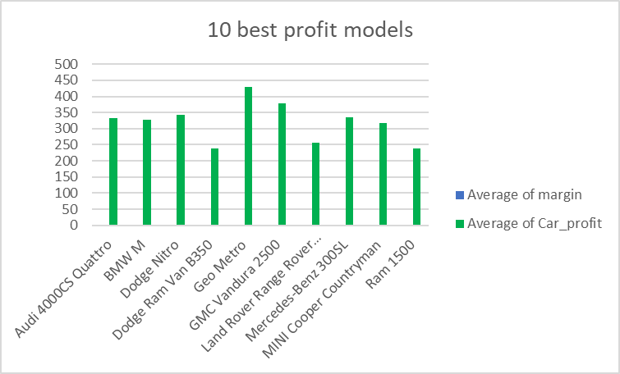
Key fidings
Many things were found during analysis of the data
But two of them will help us for a good observation:
Top 10 car are the most profitable

Slide 7
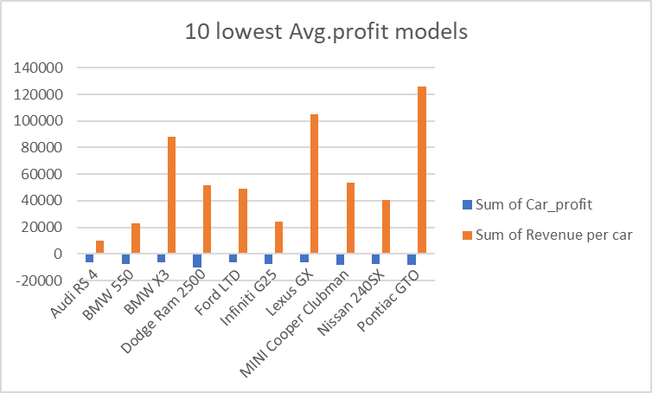
Key findings
The 2nd observation is that:
Top 10 lowest Models

Slide 8
Recommandations
BY increansing the % number of cars by 10,5% the top 10 maximize the profit for the lowest ones

Slide 9
CALL TO ACTION
After increasing the number of top car by 10%,5% and reducing the lowest it increases the profit

Slide 10
THANK YOU

